Slide 1


Slide 2
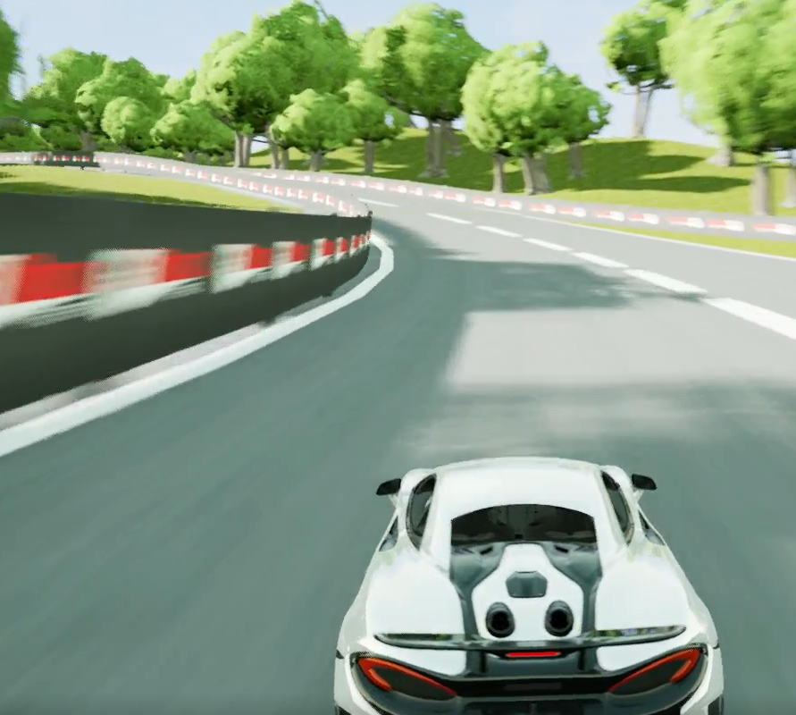
Contents
1. Project description
2. Game design
3. The Car
4. Obstacles

Slide 3
1. Project description
Racing game
Fast laps
Realistic visual
Unreal Engine.

Slide 4
2. Game design
M
Car controller;
Timer;
S
Pause menu;
Main menu;
Car choosing/multiple cars;
High-score/Lap times
Racing game
Semi realistic
Controller
C
Crashing;
Car stats screen;
Switching from 3rd to 1ste person;
Car gear changing;
W

Slide 5
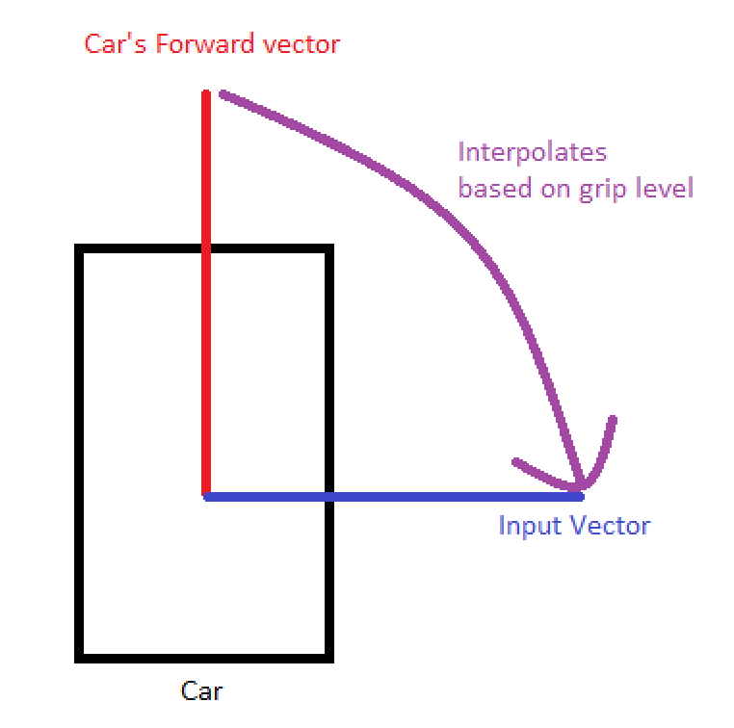
3. The Car
Input
Griplevel
Understeer
Braking
Rumble

Slide 6
4. Obstacles
Github desktop
Communication error
Unreal engine

